Slide 1
Intro to NLP in Medicine: Bag of Words Models July 10, 2020
Applied Data Science
MMCi Term 4
Matthew Engelhard
Notes:
NEED INFO ABOUT ROC, CONFUSION MATRIX, ETC HERE

Slide 2
Lecture Outline
What is natural language processing?
What can NLP do?
What can NLP do in medicine?
How does it work? (version 1)
Next time: How does it work (version 2)

Slide 3
What is Natural Language Processing?
Notes:
All that is to say – promising work has happened and will continue to happen. But NLP has potential to do so much more – think of the amount of work that is done combing through the chart before a visit. We’d like to be able to ask questions to be able to orient us to a patient.
Documentation keeps growing
Like to use tools to cut down on the ever-growing documentation burden placed on providers

Slide 4


Sentiment Analysis
Machine Learning Model
“That movie was terrible!”
“This is the best jacket that I’ve ever owned”
“Not really that good.”

Slide 5
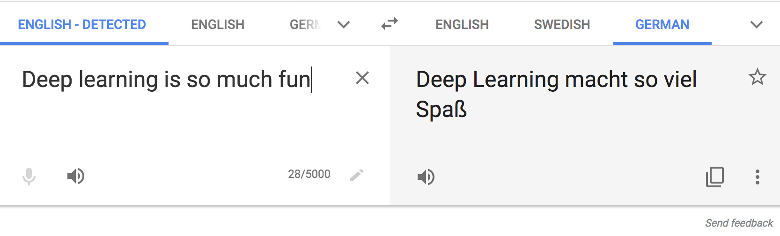
Translation
translate.google.com

Slide 6
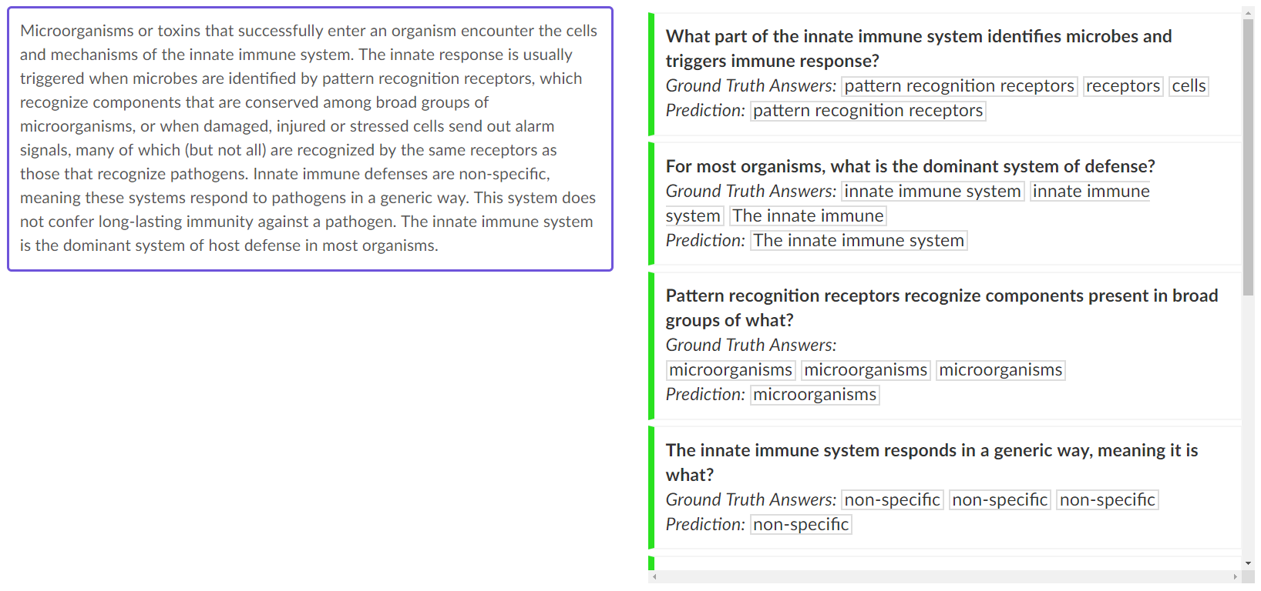
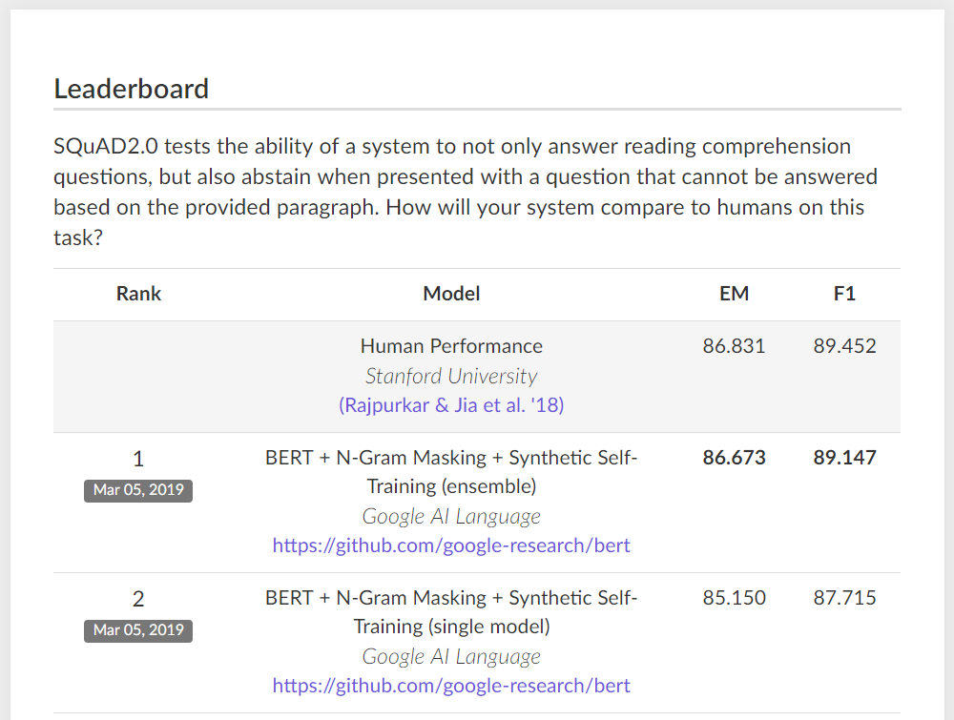
Question Answering
Notes:
SQuAD 2.0 developed in 2016
Paragraphs of content along with questions about that content
Here we have paragraph about the immune system along with relevant questions that can be answered. But again, not all of these questions can be answered, and it is important for the system to recognize this.
Exact match. This metric measures the percentage of predictions that match any one of the ground truth answers exactly.
(Macro-averaged) F1 score. This metric measures the average overlap between the prediction and ground truth answer. We treat the prediction and ground truth as bags of tokens, and compute their F1. We take the maximum F1 over all of the ground truth answers for a given question, and then average over all of the questions

Slide 7
Text Generation
SYSTEM PROMPT (HUMAN-WRITTEN)
A train carriage containing controlled nuclear materials was stolen in Cincinnati today. Its whereabouts are unknown.
MODEL COMPLETION (MACHINE-WRITTEN, FIRST TRY)
The incident occurred on the downtown train line, which runs from Covington and Ashland stations.
In an email to Ohio news outlets, the U.S. Department of Energy said it is working with the Federal Railroad Administration to find the thief.
“The theft of this nuclear material will have significant negative consequences on public and environmental health, our workforce and the economy of our nation,” said Tom Hicks, the U.S. Energy Secretary, in a statement. “Our top priority is to secure the theft and ensure it doesn’t happen again.”
The stolen material was taken from the University of Cincinnati’s Research Triangle Park nuclear research site, according to a news release from Department officials.
The Nuclear Regulatory Commission did not immediately release any information.
According to the release, the U.S. Department of Energy’s Office of Nuclear Material Safety and Security is leading that team’s investigation.
“The safety of people, the environment and the nation’s nuclear stockpile is our highest priority,” Hicks said. “We will get to the bottom of this and make no excuses.
“Better Language Models and Their Implications”
2/14/19
OpenAI
Notes:
Generative models based on transformer architecture and trained on 8 million webpages

Slide 8
NLP Is Central to AI-Assisted Medicine
Notes:
All that is to say – promising work has happened and will continue to happen. But NLP has potential to do so much more – think of the amount of work that is done combing through the chart before a visit. We’d like to be able to ask questions to be able to orient us to a patient.
Documentation keeps growing
Like to use tools to cut down on the ever-growing documentation burden placed on providers

Slide 9

Reducing Burden and Restoring Patient-Provider Interaction
The Burnout Crisis in American Medicine
Rena Xu
The Atlantic
May 11, 2018

Slide 10
The Doctor
(Luke Fildes, 1891)
Inspired by MLHC keynote by
Abraham Verghese, MD, MACP, Stanford University
Notes:
vur geez with a hard ‘g’, Chair of internal medicine at Stanford
Came to speak at the machine learning for healthcare conference last year about the role of machine learning in clinical practice
Fildes lost his first child, his one-year-old son, Philip, from typhoid fever on Christmas morning, 1877, and recalled the doctor attending to him compassionately
Spoke more eloquently – but the idea is that there was once an intimate relationship between doctor and patient
That relationship has been interrupted – reasons are complicated, but technology is one of them
If Sir Luke Fildes had drawn in 2018, it would look like…

Slide 11
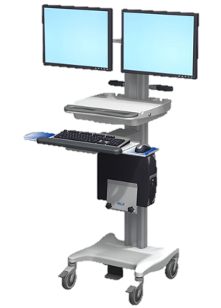
The Doctor,
circa 2018
Inspired by MLHC keynote by
Abraham Verghese, MD, MACP, Stanford University
Notes:
An exaggeration, but one based in truth
Why EHR?
– documentation trail
-- structured, standardized data
Less time for patient provider interaction
Conflict narrative structure and standardization

Slide 12
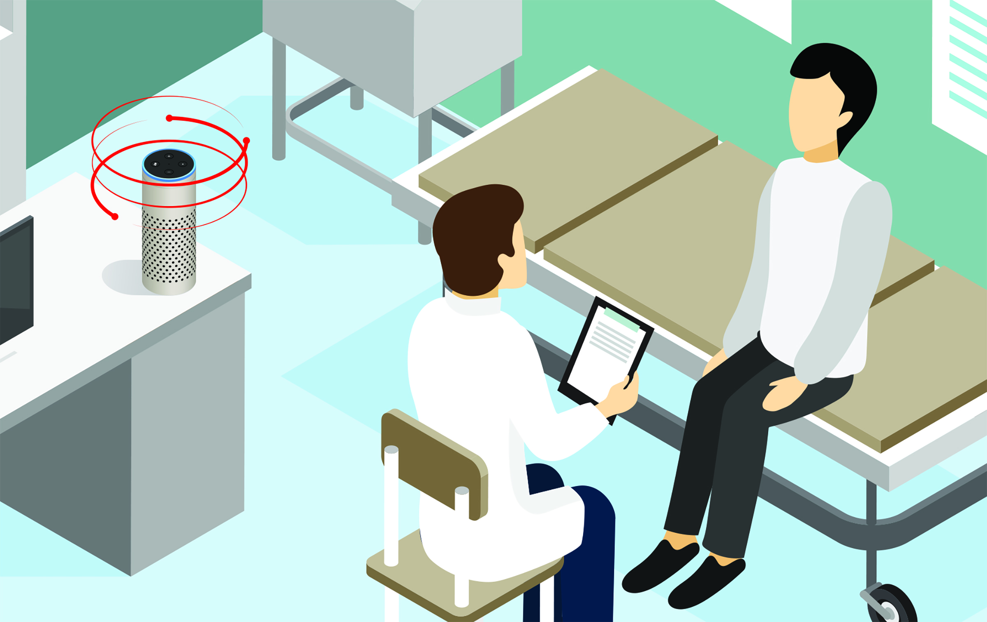
The Doctor,
circa 2030
Notes:
Device in the background to transcribe, remember, and structure to meet the needs of all these peripheral parties – so that what’s happening in the room can be focused on the patient and provider
Two parts –
Voice to words (speech processing)
and then words to meaning / understanding (NLP)

Slide 13
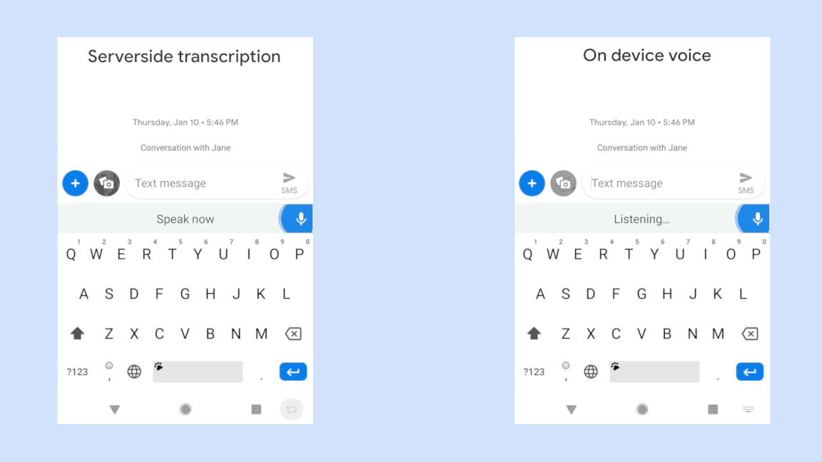
Speech Processing is Largely Solved
https://ai.googleblog.com/2019/03/an-all-neural-on-device-speech.html
Notes:
We all know speech processing is solved because we have it on our phones and in radiology (i.e. Dragon)
Know that when you talk to Alexa, the challenge isn’t whether she understands your words correctly, but understanding what you mean
Current work in compact models: RNN-T architecture
Speak a little on speech processing –
End to end and state space architectures
Point out that deep learning also found here – end to end models

Slide 14
The Doctor,
circa 2030
Use NLP to:
Populate standardized notes and fields

Slide 15
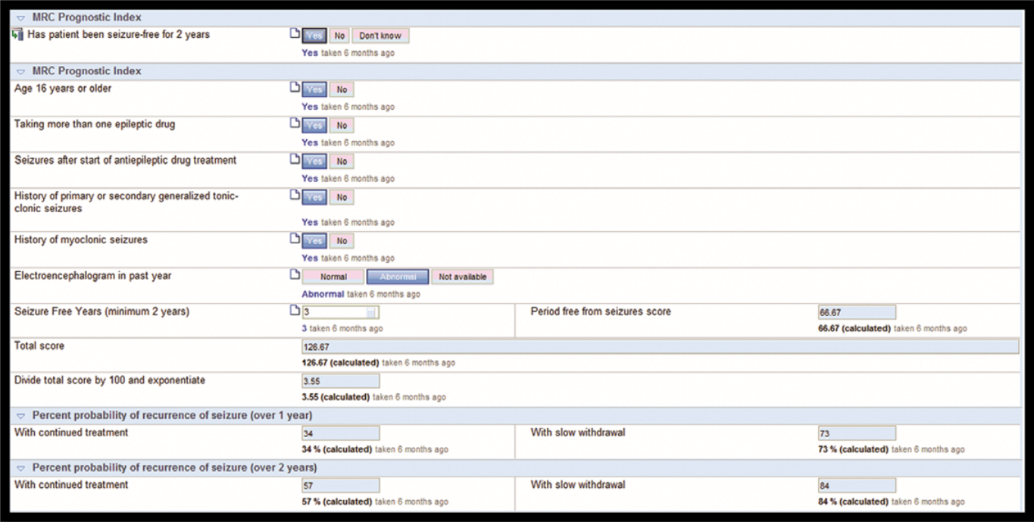
Populating Standardized Forms
Narayanan et al, Epilepsia (2017)
Notes:
Could imaging the system alerting you to data that is missing…

Slide 16
The Doctor,
circa 2030
Use NLP to:
Populate standardized notes and fields
Answer new questions from transcripts as needed
Notes:
Standard queries
Ad-hoc questions:
When did patient X first present with MS-related symptoms?
When was patient X diagnosed with multiple sclerosis?
Summarize the history of medications for MS

Slide 17

Suggested Email Responses
Notes:
Flooded with email
Not reimbursed
In the evening
Imagine a system that presents generated text that you can edit, or suggests multiple possible responses
Or “triages” messages to identify the important ones or categorize them
Seeing this happen with suggested responses in Gmail

Slide 18
Our Focus: Classification

Slide 19
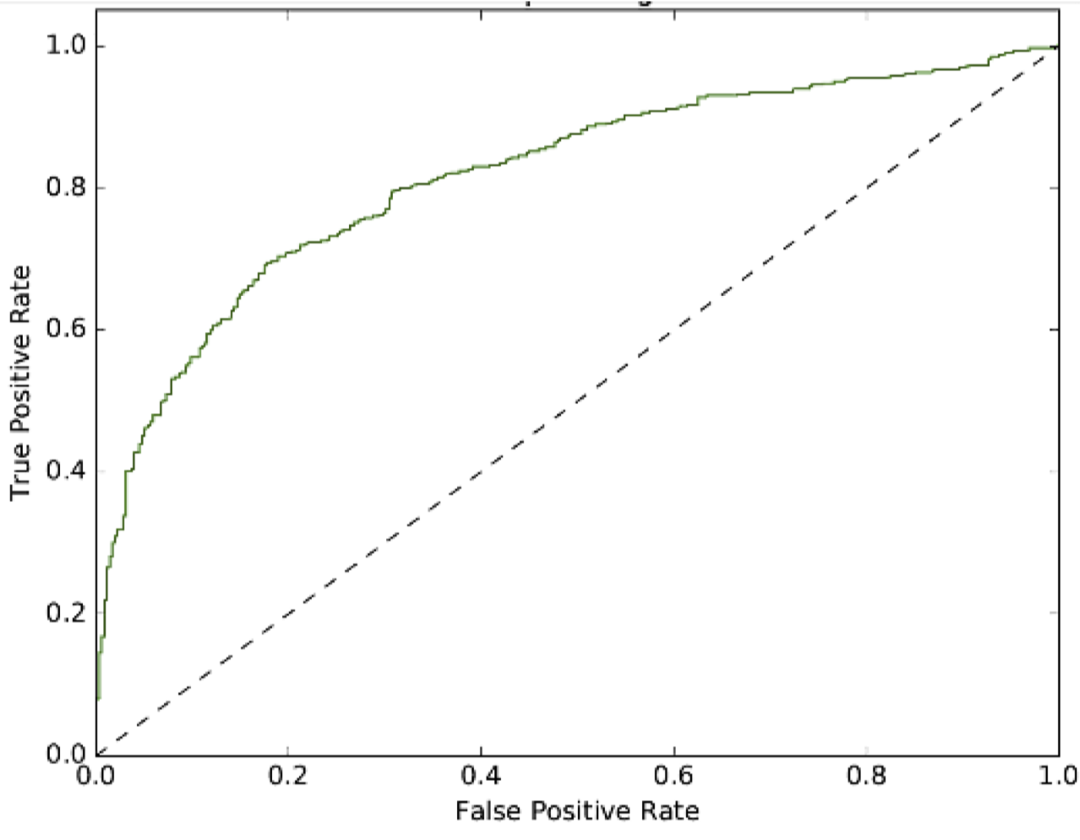
Mental Health via Social Media
Guntuku, Sharath Chandra, et al. "Language of ADHD in Adults on Social Media." Journal of attention disorders (2017): 1087054717738083.
AUC = 0.836
Binary Classification: ADHD or not ADHD
Notes:
Note that both of these use simple models (bag of words, logistic regression)
Mention that word vectors are really powerful and we have found SWEM to work well
Language of ADHD is linearSVM

Slide 20
Mental Health via Social Media
?
r/depression r/SuicideWatch
De Choudhury, Munmun, et al. "Discovering shifts to suicidal ideation from mental health content in social media." Proceedings of the 2016 CHI conference on human factors in computing systems. ACM, 2016.
Binary Classification: Suicidal Ideation? (Yes/No)
Notes:
Note that both of these use simple models (bag of words, logistic regression)
Mention that word vectors are really powerful and we have found SWEM to work well
Language of ADHD is linearSVM

Slide 21
Global Maternal Health
Maternal Health HelpDesk:
2 million women connected to NDoH staff via SMS
https://www.praekelt.org
Binary Classification: Urgent Message? (Yes/No)
Notes:
F1-score is harmonic mean of the two

Slide 22
How does this fit in our Previous Framework?

Slide 23
Text Classification
https://www.praekelt.org
Can we use logistic regression to solve this problem?
Notes:
F1-score is harmonic mean of the two

Slide 24
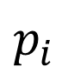

How can we use logistic regression for text classification?
$$p_{i}$$
$$σ$$
This looks good…
z_{i}
b₁
b_{M}
x_{i1}
x_{iM}
But what are our features??

Slide 25
ICU Mortality: APACHE III
???
WBC Count
Respiratory Rate
Creatinine
Mean BP
Hematocrit
Age
Temperature
Pulse Rate
Survival
End goal: predict odds of hospital mortality
Notes:
ACUTE PHYSIOLOGY AND CHRONIC HEALTH EVALUATION
Predictive models are nothing new in medicine – APACHE, for instance – this is to predict mortality in ICU setting – has been around since the 70s.
In an ICU setting, we might want a model that takes a bunch of measurements about a patient -- their age (demographics), vitals, lab values, and some information about chronic health conditions and predicts their risk of dying (or likelihood of surviving…)

Slide 26
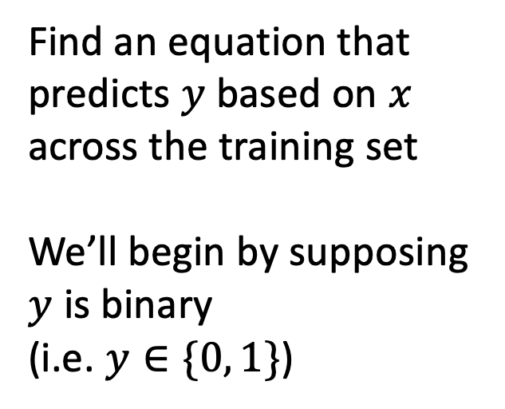
Training Set (Historical Data)
x₁
y₁
Find an equation that predicts $y$ based on $x$ across the training set
We’ll begin by supposing $y$ is binary
(i.e. $y∈\{0, 1\}$)
x₂
y₂
x₃
y₃
x₄
y₄
…
…
x_{N-1}
y_{N-1}
x_{N}
y_{N}
Notes:
How do we do that?
Gather a bunch of historical data
Want to find an equation that predicts y well based on x across that historical data
Y could be a numeric value, or a rank – but today, we’re going to assume that y is binary.
We model (y) as a Bernoulli random variable – this just means that it’s an event that may or may not occur, with some probability – and we suppose that probability is a function of x
So we take all this data, we use it to find the parameters that are most consistent with the patterns of x and y that are present

Slide 27
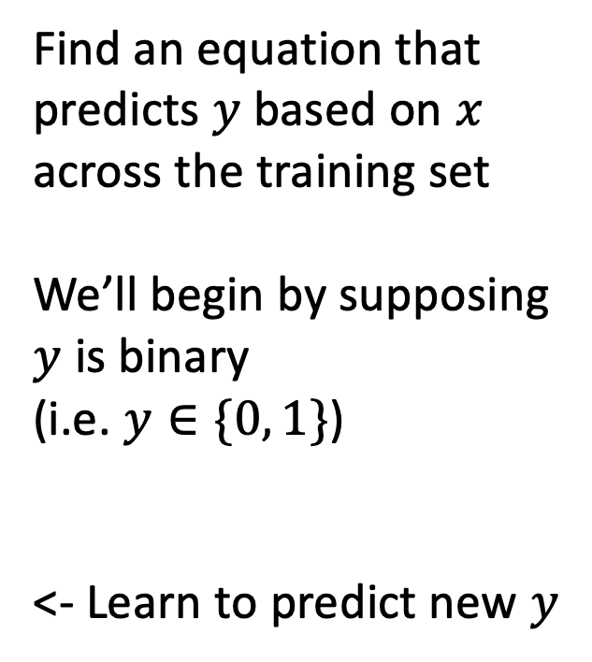

Making Predictions for New $x$
x₁
y₁
x₂
y₂
Find an equation that predicts $y$ based on $x$ across the training set
We’ll begin by supposing $y$ is binary
(i.e. $y∈\{0, 1\}$)
<- Learn to predict new $y$
x₃
y₃
x₄
y₄
…
…
x_{N-1}
y_{N-1}
x_{N}
y_{N}
x_{N+1}
y_{N+1}
Notes:
Having done that, we have a trained model. Our parameters are learned – we hold them fixed.
Now, when we see a NEW value of x, we simply plug it into our “learned” equation, and it tells us what we expect y to be. This is prediction.

Slide 28
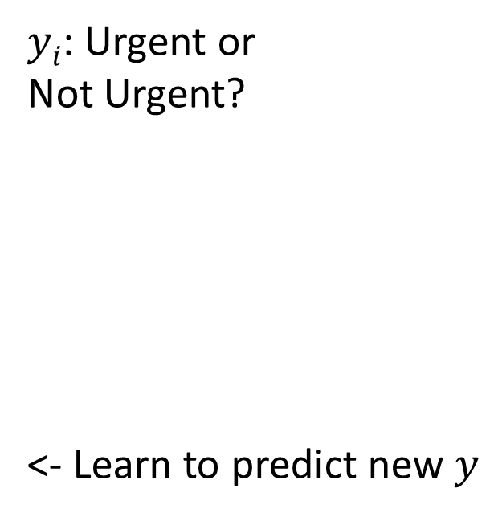
This time, our training data is text
x₁
What helps with morning sickness?
How many months should I breastfeed?
I passed out and Mom said I was shaking
Where is the nearest clinic?
I am having heavy bleeding, what should I do?
What foods should I eat while pregnant?
My heart is racing and I can’t catch my breath
y₁
x₂
y₂
x₃
y₃
$yi$: Urgent or
Not Urgent?
<- Learn to predict new $y$
x₄
y₄
…
…
x_{N-1}
y_{N-1}
x_{N}
y_{N}
x_{N+1}
y_{N+1}
Notes:
Having done that, we have a trained model. Our parameters are learned – we hold them fixed.
Now, when we see a NEW value of x, we simply plug it into our “learned” equation, and it tells us what we expect y to be. This is prediction.

Slide 29
We need numbers, not words
Can we convert our text to a vector or sequence of numbers?
If yes, we can start using our previous methodology!

Slide 30
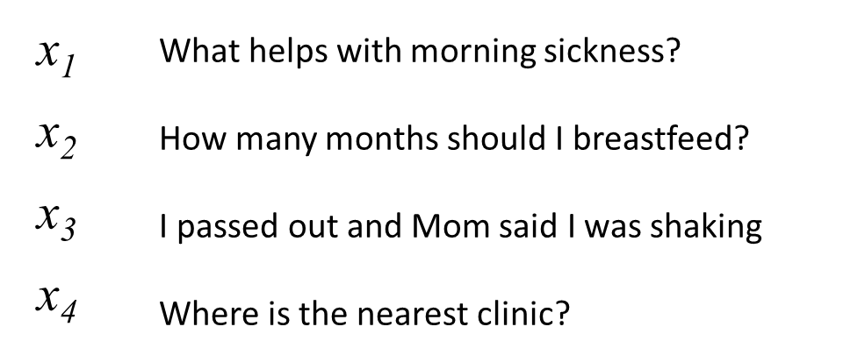
First try: count words in each SMS Step 1: Define a vocabulary of words
shaking
what
clinic
how
helps
was
nearest
many
with
said
months
the
morning
mom
should
sickness
and
I
is
how
out
breastfeed
passed
where
list of all words
(in no particular order)

Slide 31
Step 2: count how many times each vocabulary word appears in a given SMS
shaking
what
clinic
how
helps
was
nearest
many
with
said
months
the
morning
mom
should
sickness
and
I
is
how
out
breastfeed
passed
where
What helps with morning sickness?
x₁
0 | 1 | 0 | 0 | 1 | 0 | 0 | 0 | 1 | 0 | 0 | 0 | 1 | 0 | 0 | 1 | 0 | 0 | 0 | 0 | 0 | 0 | 0 | 0
Notes:
ACUTE PHYSIOLOGY AND CHRONIC HEALTH EVALUATION
Predictive models are nothing new in medicine – APACHE, for instance – this is to predict mortality in ICU setting – has been around since the 70s.
In an ICU setting, we might want a model that takes a bunch of measurements about a patient -- their age (demographics), vitals, lab values, and some information about chronic health conditions and predicts their risk of dying (or likelihood of surviving…)

Slide 32
Step 2: count how many times each vocabulary word appears in a given SMS
shaking
what
clinic
how
helps
was
nearest
many
with
said
months
the
morning
mom
should
sickness
and
I
is
how
out
breastfeed
passed
where
I passed out and Mom said I was shaking
x₃
1 | 0 | 0 | 0 | 0 | 1 | 0 | 0 | 0 | 1 | 0 | 0 | 0 | 1 | 0 | 0 | 0 | 2 | 0 | 0 | 1 | 0 | 1 | 0
Notes:
ACUTE PHYSIOLOGY AND CHRONIC HEALTH EVALUATION
Predictive models are nothing new in medicine – APACHE, for instance – this is to predict mortality in ICU setting – has been around since the 70s.
In an ICU setting, we might want a model that takes a bunch of measurements about a patient -- their age (demographics), vitals, lab values, and some information about chronic health conditions and predicts their risk of dying (or likelihood of surviving…)

Slide 33
Step 2: count how many times each vocabulary word appears in a given SMS
shaking
what
clinic
how
helps
was
nearest
many
with
said
months
the
morning
mom
should
sickness
and
I
is
how
out
breastfeed
passed
where
Where is the nearest clinic?
x₄
0 | 0 | 1 | 0 | 0 | 0 | 1 | 0 | 0 | 0 | 0 | 1 | 0 | 0 | 0 | 0 | 0 | 0 | 1 | 0 | 0 | 0 | 0 | 1
Notes:
ACUTE PHYSIOLOGY AND CHRONIC HEALTH EVALUATION
Predictive models are nothing new in medicine – APACHE, for instance – this is to predict mortality in ICU setting – has been around since the 70s.
In an ICU setting, we might want a model that takes a bunch of measurements about a patient -- their age (demographics), vitals, lab values, and some information about chronic health conditions and predicts their risk of dying (or likelihood of surviving…)

Slide 34
Note that word order does not matter!
shaking
what
clinic
how
helps
was
nearest
many
with
said
months
the
morning
mom
should
sickness
and
I
is
how
out
breastfeed
passed
where
clinic is where nearest the
x_{4'}
0 | 0 | 1 | 0 | 0 | 0 | 1 | 0 | 0 | 0 | 0 | 1 | 0 | 0 | 0 | 0 | 0 | 0 | 1 | 0 | 0 | 0 | 0 | 1
Notes:
ACUTE PHYSIOLOGY AND CHRONIC HEALTH EVALUATION
Predictive models are nothing new in medicine – APACHE, for instance – this is to predict mortality in ICU setting – has been around since the 70s.
In an ICU setting, we might want a model that takes a bunch of measurements about a patient -- their age (demographics), vitals, lab values, and some information about chronic health conditions and predicts their risk of dying (or likelihood of surviving…)

Slide 35

A “bag of words”
clinic
nearest
where
the
is

Slide 36

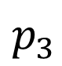
Logistic Regression for Text Classification
shaking
what
clinic
how
helps
was
nearest
many
with
said
months
the
morning
mom
should
sickness
and
I
is
how
out
breastfeed
passed
where
$$p_{3}$$
$$σ$$
z₃
b₁
b_{M}
x₃
1 | 0 | 0 | 0 | 0 | 1 | 0 | 0 | 0 | 1 | 0 | 0 | 0 | 1 | 0 | 0 | 0 | 2 | 0 | 0 | 1 | 0 | 1 | 0
I passed out and Mom said I was shaking

Slide 37
Logistic Regression for Text Classification
shaking
what
clinic
how
helps
was
nearest
many
with
said
months
the
morning
mom
should
sickness
and
I
is
how
out
breastfeed
passed
where
$$p_{3}$$
$$σ$$
z₃
b₁
b_{M}
x₃
1 | 0 | 0 | 0 | 0 | 1 | 0 | 0 | 0 | 1 | 0 | 0 | 0 | 1 | 0 | 0 | 0 | 2 | 0 | 0 | 1 | 0 | 1 | 0
I passed out and Mom said I was shaking

Slide 38
Logistic Regression for Text Classification
shaking
what
clinic
how
helps
was
nearest
many
with
said
months
the
morning
mom
should
sickness
and
I
is
how
out
breastfeed
passed
where
$$p_{3}$$
near 1 (urgent)
$$σ$$
large
z₃
b₁
b_{M}
x₃
1 | 0 | 0 | 0 | 0 | 1 | 0 | 0 | 0 | 1 | 0 | 0 | 0 | 1 | 0 | 0 | 0 | 2 | 0 | 0 | 1 | 0 | 1 | 0
I passed out and Mom said I was shaking

Slide 39
Strengths and Weaknesses
(+) This approach is simple and works surprisingly well in practice
(+) Often the best approach with small datasets
(-) Does not capture word order
(-) Does not group synonyms together or understand semantic relationships between words

Slide 40
2nd try: count 1- and 2-grams in each SMS (i.e. extend vocabulary to include 2-word phrases)
shaking
what
clinic
how
helps
was
nearest
many
with
said
months
the
morning
mom
should
sickness
and
I
is
how
out
breastfeed
passed
where
1-grams
what helps
helps with
with morning
morning sickness
how many
many months
months should
should I
I breastfeed
I passed
passed out
out and
and mom
mom said
said I
I was
was shaking
where is
is the
the nearest
nearest clinic
2-grams

Slide 41
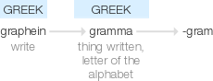
-gram¹
combining form
suffix: -gram
in nouns denoting something written or recorded (especially in a certain way).
"cryptogram"
Origin
from Greek gramma ‘thing written, letter of the alphabet’, from graphein ‘write’.

Slide 42
n-grams can be very helpful!
I am not sick and feel great
Bag of 1-grams: no difference between these sentences
I am not great and feel sick

Slide 43
n-grams can be very helpful!
I am not sick and feel great
Bag of 1- and 2-grams:
not sick, feel great
versus
not great, feel sick
I am not great and feel sick

Slide 44
3rd try: more powerful methods to work with…
(a) word meaning: assign words to vectors that encode their meaning numerically
(b) words in context: neural network architectures that act on sequences of words (rather than a bag of words)
More on this next lecture

Slide 45
Miscellaneous Text Processing Details
Bag of Words

Slide 46
Variations on counting: term frequency
term count: ‘times’
“It was the best of times, it was the worst of times, it was the age of wisdom, it was the age of foolishness, it was the epoch of belief, it was the epoch of incredulity, it was the season of Light, it was the season of Darkness, it was the spring of hope, it was the winter of despair, we had everything before us, we had nothing before us, we were all going direct to Heaven, we were all going direct the other way—in short, the period was so far like the present period, that some of its noisiest authorities insisted on its being received, for good or for evil, in the superlative degree of comparison only.”
2
“And the first one now Will later be last For the times they are a-changin'.”
1

Slide 47
Variations on counting: term frequency
term frequency: ‘times’
“It was the best of times, it was the worst of times, it was the age of wisdom, it was the age of foolishness, it was the epoch of belief, it was the epoch of incredulity, it was the season of Light, it was the season of Darkness, it was the spring of hope, it was the winter of despair, we had everything before us, we had nothing before us, we were all going direct to Heaven, we were all going direct the other way—in short, the period was so far like the present period, that some of its noisiest authorities insisted on its being received, for good or for evil, in the superlative degree of comparison only.”
2/119
“And the first one now Will later be last For the times they are a-changin'.”
1/16
-> better measure of the importance of
the term within a given text sample

Slide 48
Variations on counting: inverse document frequency
2/2
document frequency: ‘times’
“It was the best of times, it was the worst of times, it was the age of wisdom, it was the age of foolishness, it was the epoch of belief, it was the epoch of incredulity, it was the season of Light, it was the season of Darkness, it was the spring of hope, it was the winter of despair, we had everything before us, we had nothing before us, we were all going direct to Heaven, we were all going direct the other way—in short, the period was so far like the present period, that some of its noisiest authorities insisted on its being received, for good or for evil, in the superlative degree of comparison only.”
✔
✔
“And the first one now Will later be last For the times they are a-changin'.”

Slide 49
Variations on counting: inverse document frequency
1/2
document frequency: ‘evil’
“It was the best of times, it was the worst of times, it was the age of wisdom, it was the age of foolishness, it was the epoch of belief, it was the epoch of incredulity, it was the season of Light, it was the season of Darkness, it was the spring of hope, it was the winter of despair, we had everything before us, we had nothing before us, we were all going direct to Heaven, we were all going direct the other way—in short, the period was so far like the present period, that some of its noisiest authorities insisted on its being received, for good or for evil, in the superlative degree of comparison only.”
✔
X
“And the first one now Will later be last For the times they are a-changin'.”

Slide 50
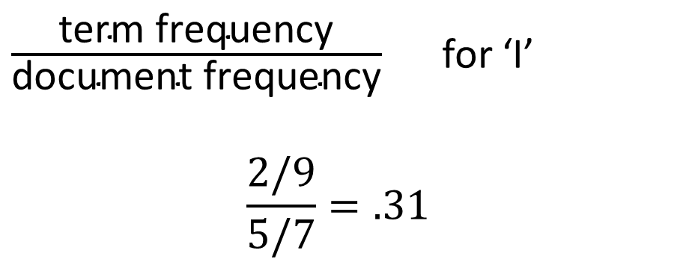
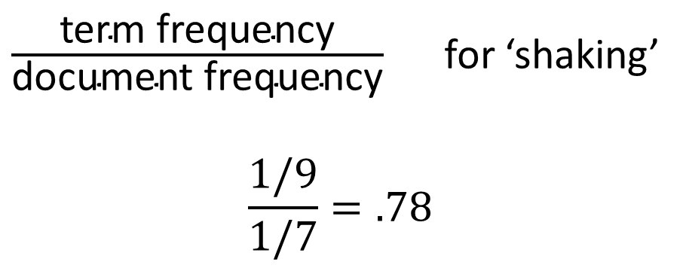
term frequency-inverse document frequency (tf-idf)
What helps with morning sickness?
How many months should I breastfeed?
I passed out and Mom said I was shaking
Where is the nearest clinic?
I am having heavy bleeding, what should I do?
What foods should I eat while pregnant?
My heart is racing and I can’t catch my breath
$\frac{\text{term} \text{frequency}}{\text{document} \text{frequency}}$ for ‘shaking’
$$\frac{1/9}{1/7}=.78$$
$\frac{\text{term} \text{frequency}}{\text{document} \text{frequency}}$ for ‘I’
$$\frac{2/9}{5/7}=.31$$

Slide 51
Preprocessing
I passed out, and Mom said I was shaking.
remove punctuation
to lowercase
“tokenization”
“stemming”
I passed out and Mom said I was shaking
i passed out and mom said i was shaking
[i, passed, out, and, mom, said, i, was, shaking]
[i, pass, out, and, mom, said, i, wa, shake]

Slide 52
NLP in Medicine So Far
(mostly bag of words)
Notes:
Begin with what’s happened in medicine so far – this will be half – and they we’ll talk about what to expect

Slide 53
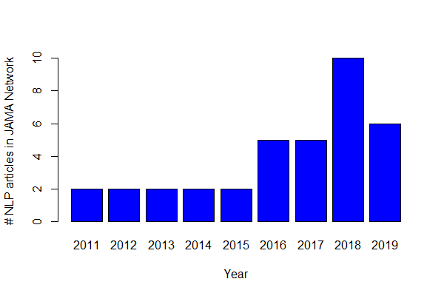
A Survey of NLP in JAMA…
Notes:
Originally looked like 38 research articles
Very rigorous search…
These are papers that mention NLP
Can see that numbers are going up, expect 2019 to be twice again what we saw in 2018
But, what you’ll find is that most of these are not NLP in the way David described…

Slide 54
A Survey of NLP in JAMA…
1 uses word vectors
28 research
articles
28 use word counts or frequencies
The majority of these search only for a limited number of keywords or expressions
Notes:
Originally looked like 38 research articles
28 are doing NLP – the remaining 10 are talking about NLP in limitations, etc
Only 1 using neural word embeddings (word2vec)
- The others are using older approaches
There are a number of reasons for this – one is medical jargon -- as you saw, pre-trained word embeddings use a dictionary that associates each word with a vector
In medicine, not all of the relevant words may be present… shorthand and abbreviations are a challenge… and the context may be quite different. Remember that word embeddings are learned based on the context in which they tend to be found. In medicine, this may be quite different
**But more than that, it’s just time.
Instead, we see many ad-hoc, rule-based systems, etc

Slide 55
A Survey of NLP in JAMA…
4 utilize EHR text features in predictive models (e.g. mortality)
28 research
articles
20 identify specific diagnoses or medical events from the EHR
4 identify other care-related information in the EHR
0 interpret words
in context
Notes:
Originally looked like 38 research articles
** None are looking directly at patient provider conversations… yet… or assisting with clinical workflow… yet
But the vast majority are simply using NLP to do things like use keywords + ICD-9 codes to refine a computable phenotype
Importantly, these models aren’t (YET) interpreting words in context. And this is where the major opportunity lies… and has facilitated question answering, text generation, etc

Slide 56
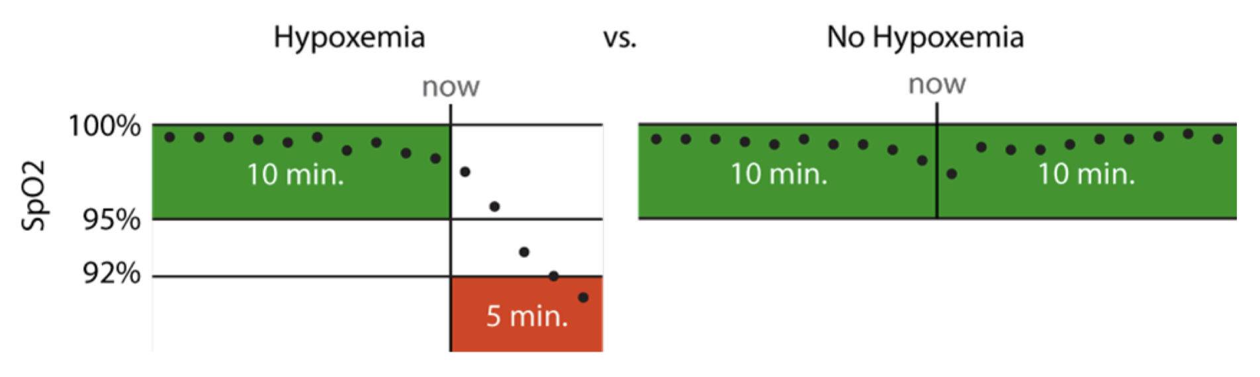
Hypoxemia Prediction during Surgery
Real-time Prediction Task:
hypoxemia (yes/no) in the next 5 minutes
based on data from the Anesthesia Information Management System
static features + real-time features collected up to that time point
Notes:
5 min window: long enough to allow an anaesthesiologist to intervene, but short enough to represent near-term risks that would benefit from immediate attention
This is actually what’s used for the anesthesiologist comparison
Model training was less strict

Slide 57
A majority of features are keyword counts
Notes:
They are not necessarily the most informative features…
But they are the largest portion by the numbers

Slide 58
Scoring Dimensional Psychopathology
Expert-generated terms for each dimension
(e.g. angry)
Final list of terms for each dimension
+
Similar terms
from DSM-IV
(e.g. hostility)
Filter by association in clinical notes
McCoy Jr, Thomas H., et al. "High throughput phenotyping for dimensional psychopathology in electronic health records." Biological psychiatry 83.12 (2018): 997-1004.
Notes:
‘negative valence’ – words indicating anger, fear, etc
‘positive valence’ – words conveying happiness, joy, etc
The point here – it’s a complicated way of identifying a list of keywords for automated scoring
Expert curated terms
Identify related words using a measure of similarity between vector representations
Use a logistic regression model to determine which of the larger set of terms are predictive of expert-curated terms in small subsamples of notes (500)
Then they simply score based on presence or absence of the larger set of terms
But again, this isn’t about natural language understanding – key distinction is models that are working on the sentence or document level rather than the word level, and that are operating based not just on individual words, but on words in context

Slide 59
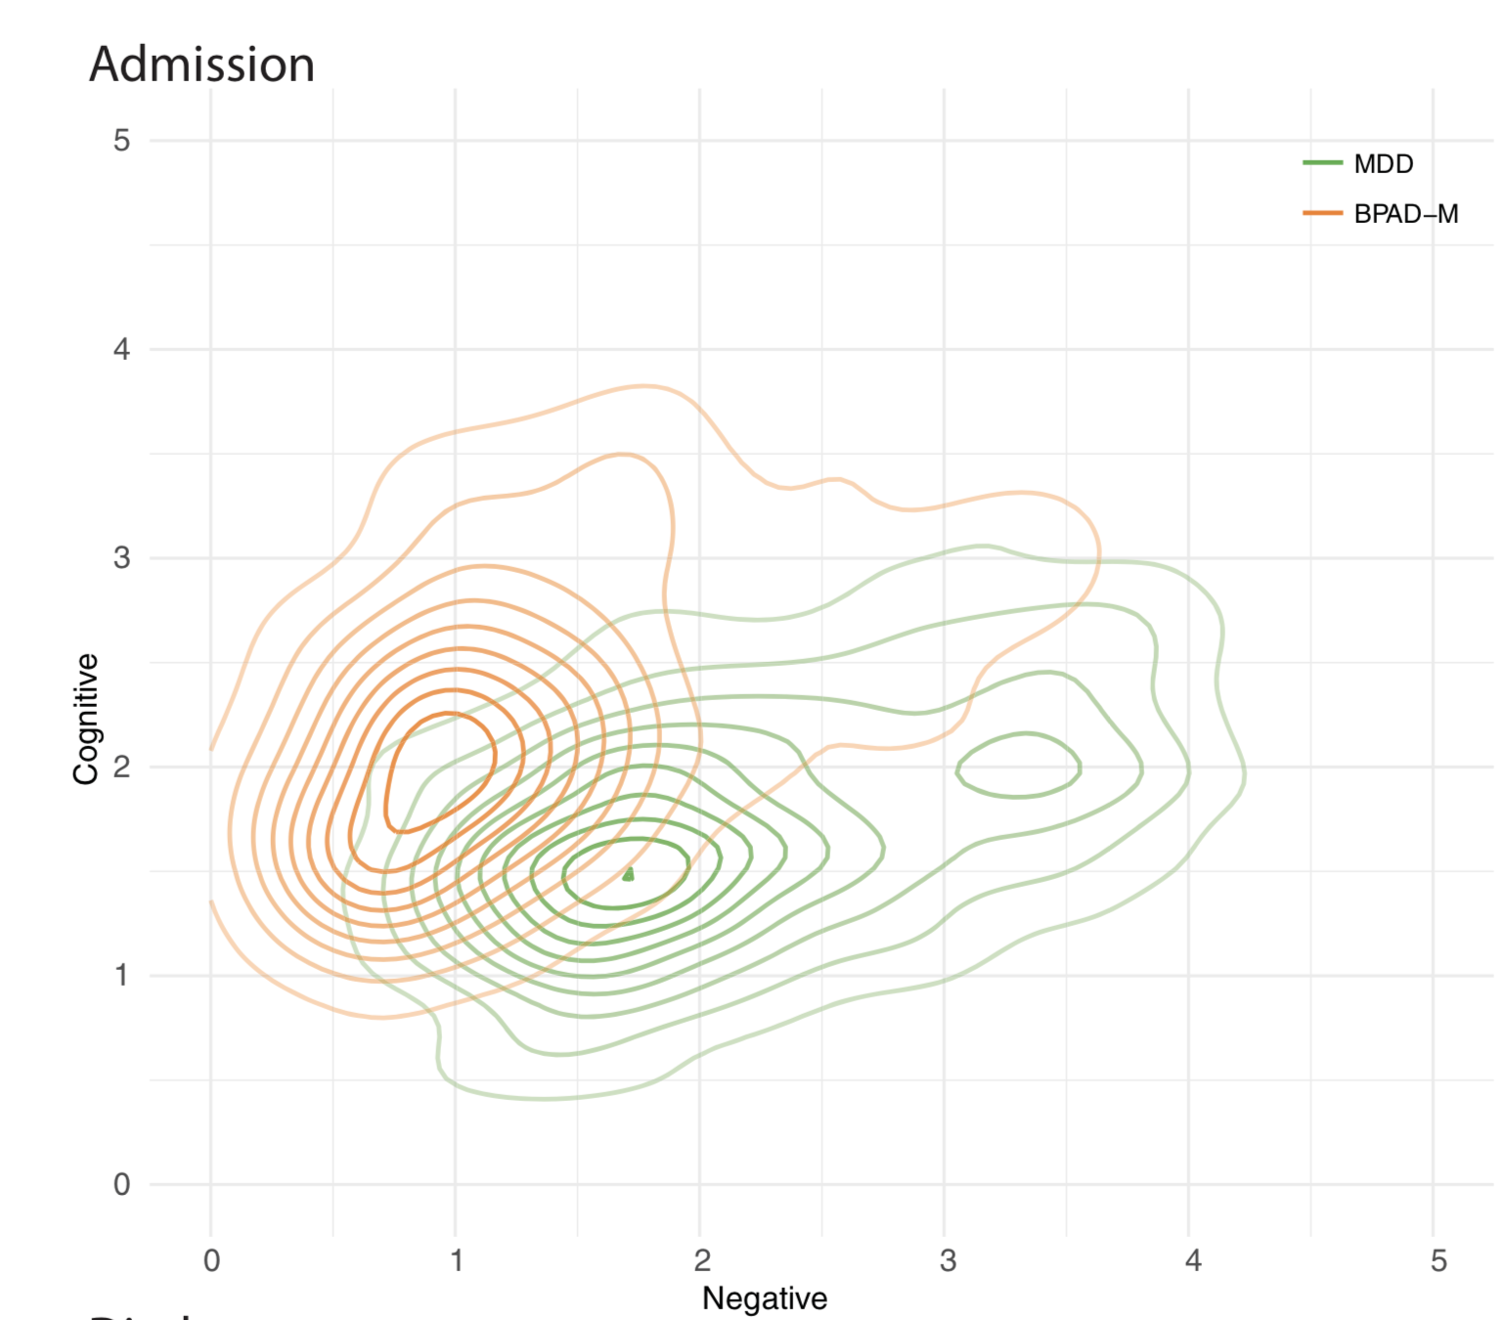
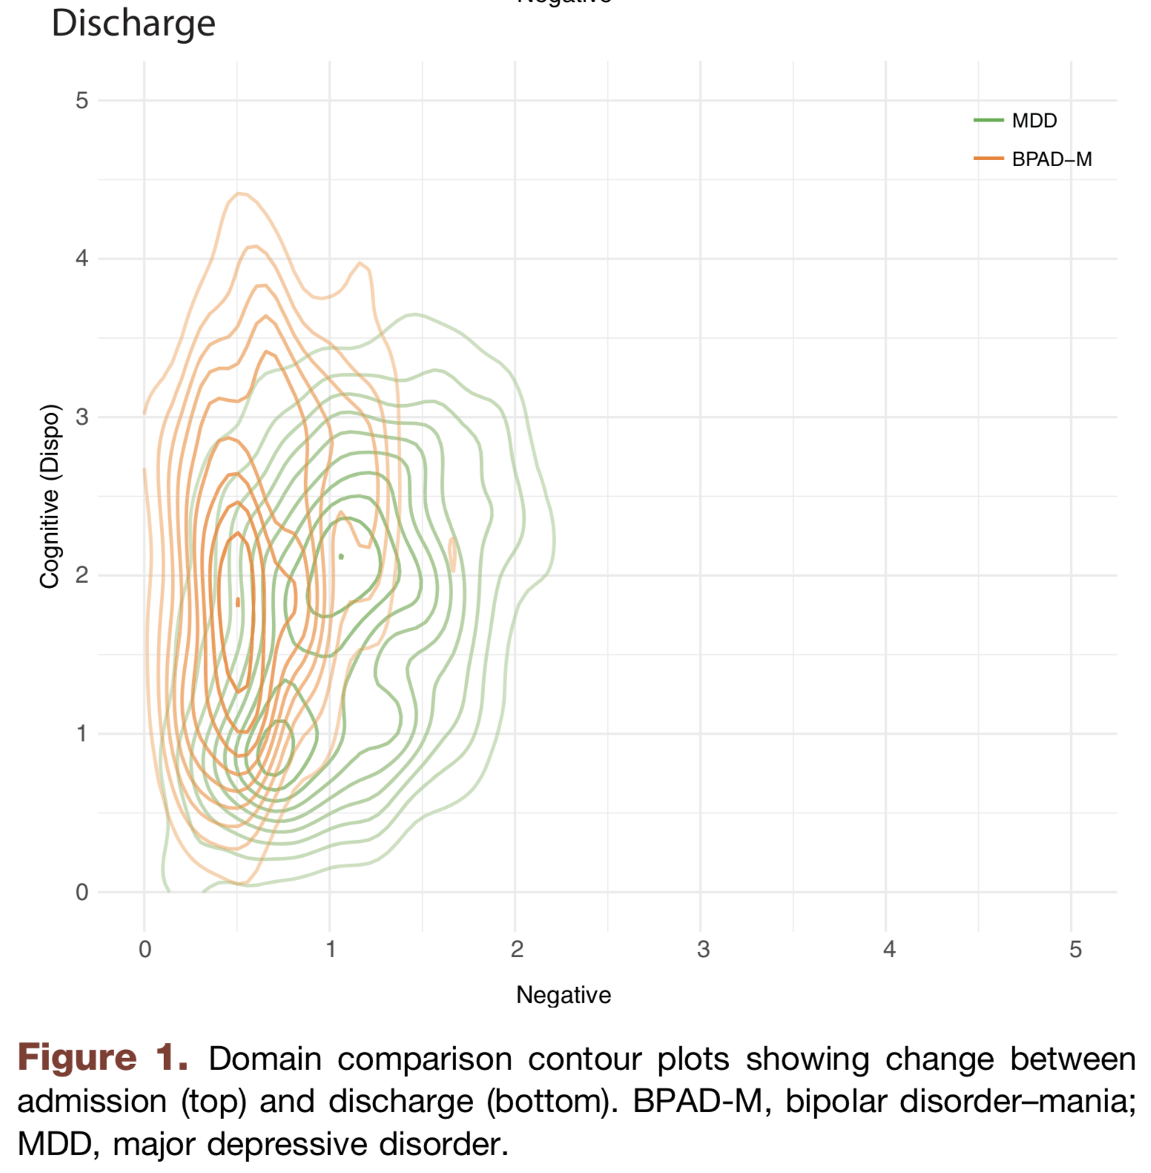
Trends in psychopathology during stay
McCoy Jr, Thomas H., et al. "High throughput phenotyping for dimensional psychopathology in electronic health records." Biological psychiatry 83.12 (2018): 997-1004.
Notes:
‘negative valence’ – words indicating anger, fear, etc
‘positive valence’ – words conveying happiness, joy, etc
The idea – have an automated method for identifying severity of dimensions of psychopathology
Then, use their score to look at descriptive statistics – i.e. admission / discharge trends and changes -- based on different psych dimensions
Able to do this at scale – paper looks at narrative clinical notes from 3619 individuals with 4623 hospital admissions
And change in these scores between admission and discharge

Slide 60
Conclusions
NLP is approaching human performance on benchmark tasks like question answering
Text data are central to clinical medicine, so the potential for NLP impact is high
We can use word counts to turn text samples into vectors that we already know how to work with
The techniques we have discussed already go beyond the majority of “NLP” found in the medical literature

